Slide 1
ML Mini Project
Problem Statement:
Finding the patterns of customer behavior to identify the Default-Customers in a financial services.
Aim: To reduces the NPAs and Increases the profitability .
Available Data of Customers: CIBIL score, payment history, credit history, geographical location, profession, income, age, education etc.

Slide 2
Step1: Data Extraction
Extracted the data from L@T financial services

Slide 3
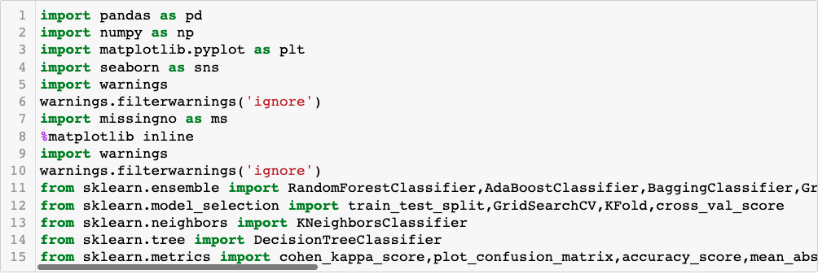
Importing the Required libraries :

Slide 4
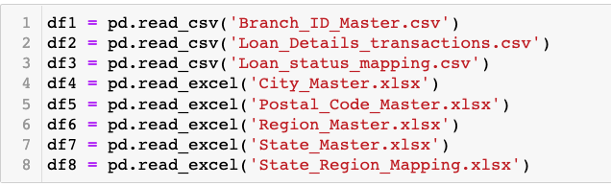
* Reading the available datasets by using pandas

Slide 5

Make the column names equal where the values are same otherwise during merging it will create duplicate values.
*Challenges faced: I used concat function to combine all tables but its just adding the table after table and creates a lot of duplicates and Nan values. After finding in net I used merge function to combine the tables

Slide 6
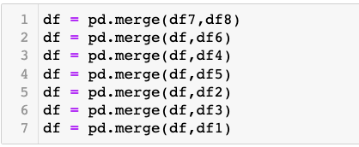
* Merging the Data Sets in to one (Note: While merging at least one column should be equal both data sets )

Slide 7
There are 162 null values in Employment type and I
Replaced with Unknown

Slide 8
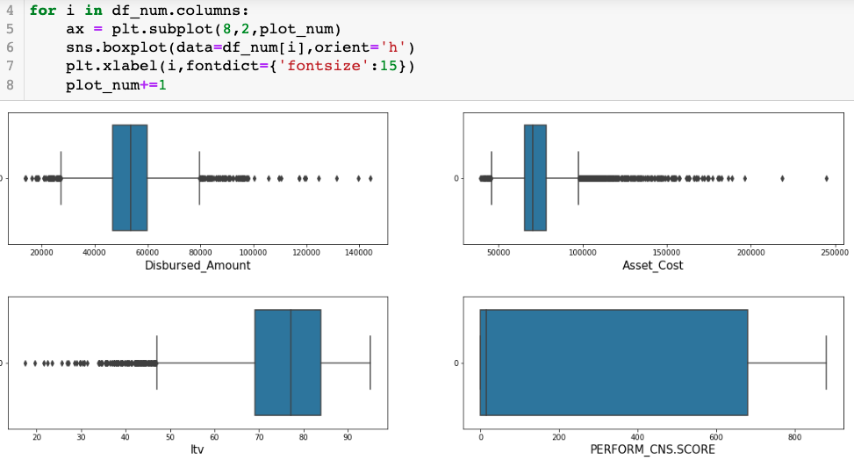
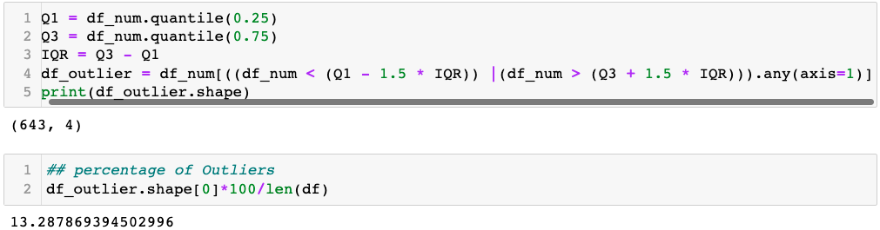
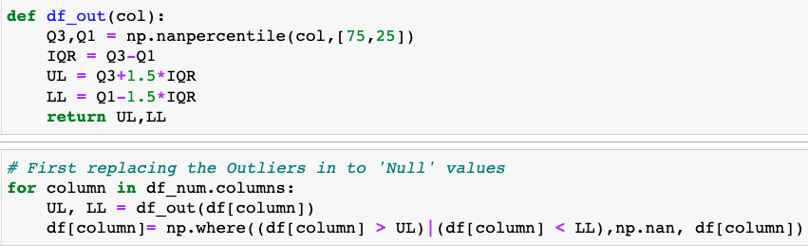
Outlier Treatment:
I used Box plot visualization to understand the outliers.
I applied the quartile method to understand the shape and percentage of
The outliers. The %age of outliers is 13.28% . Removing the outliers may
Effect the data. So I decided to replace the outliers with best possible values.
For that I applied the Quartile method to replace the outliers in to Nan values
Outliers replacing with null values
I tried with transformation techniques by visualization but there is no change even after transformed

Slide 9
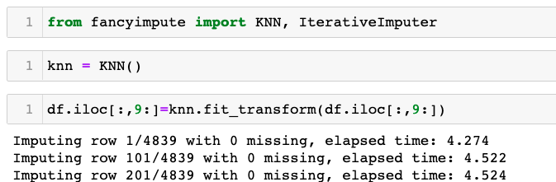
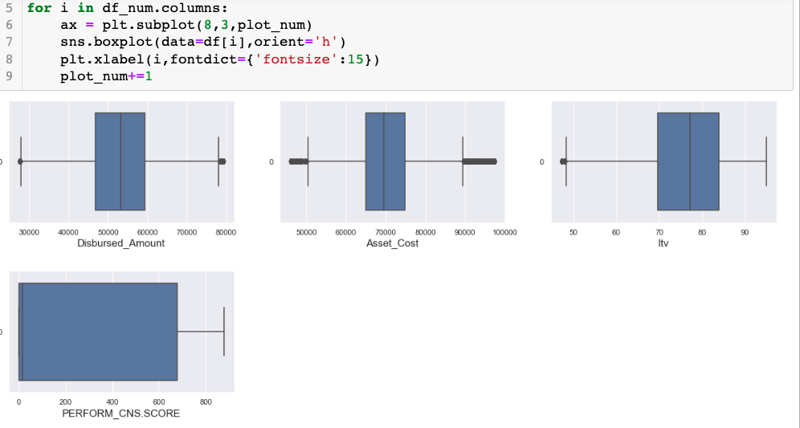
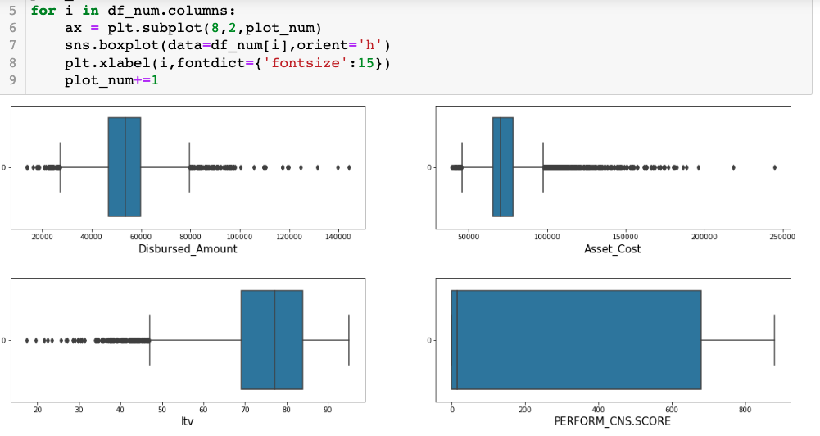
Imputing Outliers with KNN
for missing values treatment Generally we use mode for categorical and for numerical values we use mean, median and also like climate based data we will use Ffill and Bfill methods to impute the missing values.
but here I used KNN method to impute the numerical missing values
Knn will impute the values by nearest neighbor. I believe this is efficient way to fill the numerical missing values for this time.
After Outlier treatment
Before Outlier Treatment

Slide 10
Missing Values Treatment
I did Missing values treatment after outlier treatment because what I observed is.
Reason1 : when we are treating missing values before outlier treatment, mean value is effected by outliers
Reason 2 : If outliers are < 5%, most of cases we can drop outliers. If outliers percentage is more, that will impact model efficiency. In some special cases even small percentage of outliers is important. To keep this in mind we have to treat outliers most efficient way. In this dataset I applied KNN method to impute the outliers. For that, 1st I changed outliers in to nan values then I imputed the nan values with KNN. For missing values also I am applying KNN method to impute. If I apply KNN impute after the outlier treatment, at a time we can impute the missing values and outliers.

Slide 11
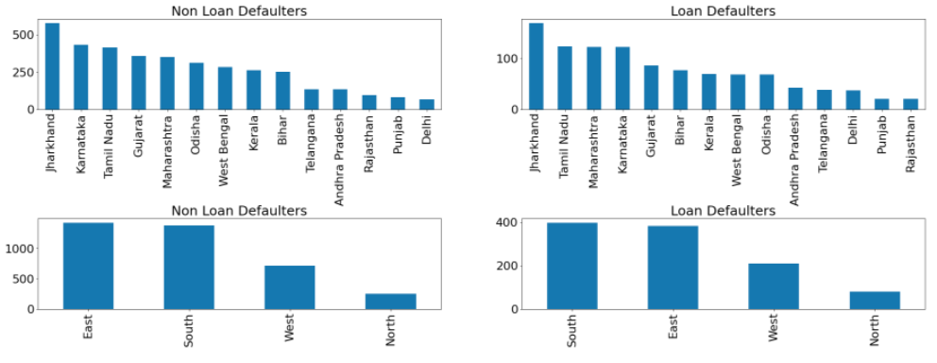
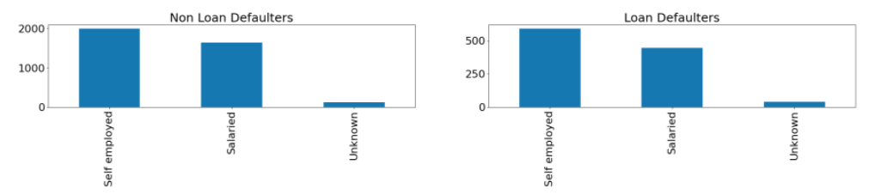
Data Visualizations
Python Visualizations to understand the data
Observations:
Loan Defaulter’s:
Top loan Defaulters:
State: Jharkhand, TamilNadu, Maharashtra & Karnataka
Region: South
Employment: Self Employed

Slide 12
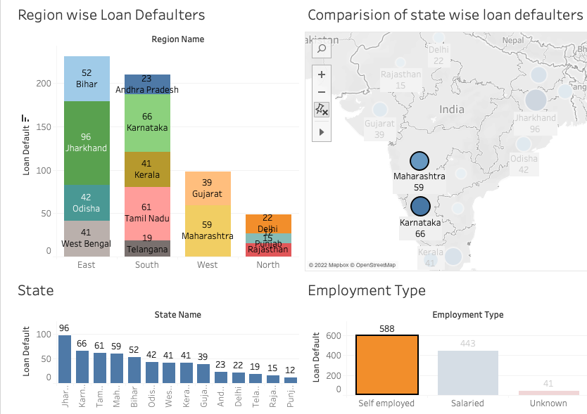
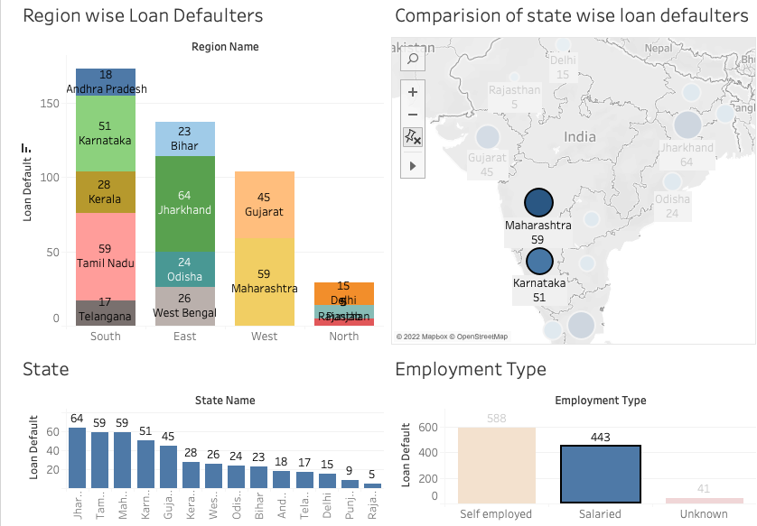
Tableau Visualizations
Observations:
Relational changes :
Highest no. of Defaulters:
Self Employed: East Region
Salaried: South Region

Slide 13
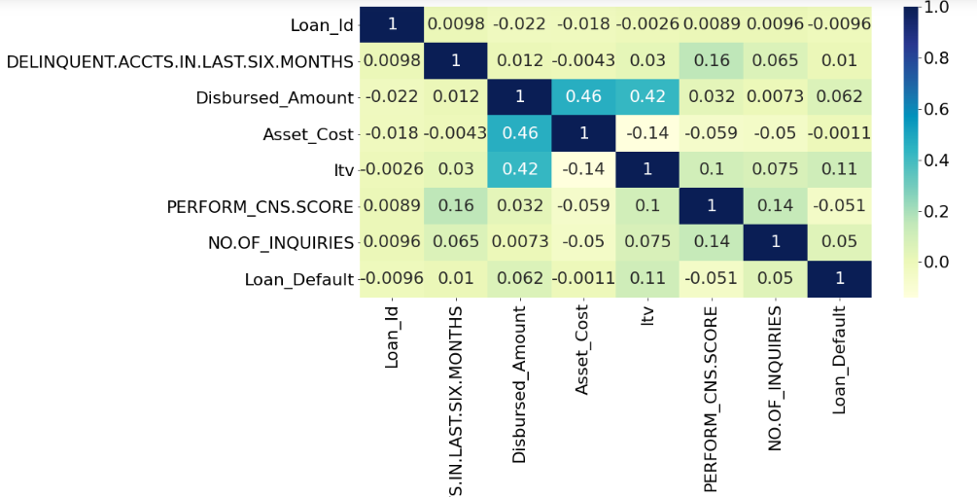
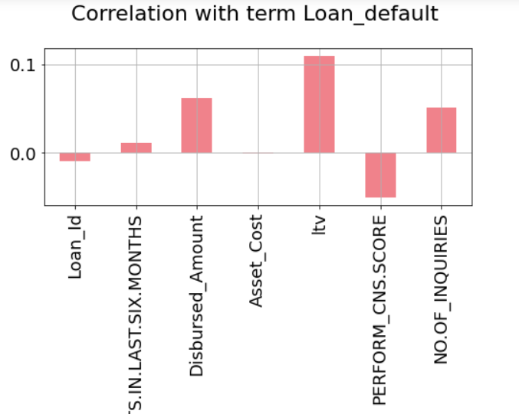
Correlation map
We can Observe the graphs below:
1st Graph gives complete picture of correlation of all elements
2nd Graph shows correlation between target variable and independent variables.
We can clearly observe positive and negative correlation.

Slide 14
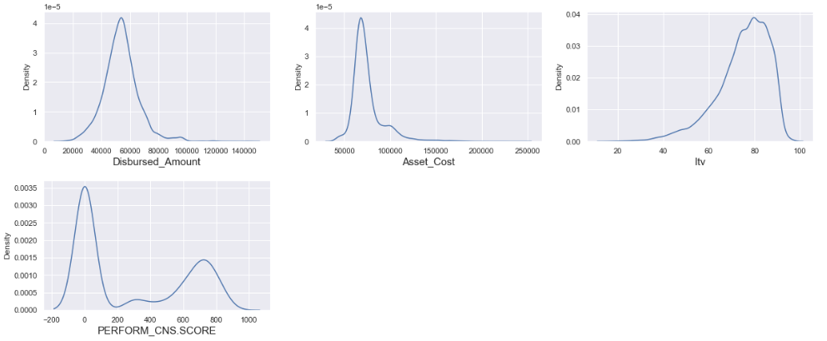
Statistical Method's
I used Statistical Tests to find the relationship between target variable and Independent variables
Step1: Checking the data is following normal Distribution or not
I used KDE plot to visualize the distribution of the features:
Observations:
1.Disbursed_amount: slightly right skewed
2. Asset_cost: right skewed
3. ltv: left skewed
4. perform_CNS.SCORE: not following normal distribution
After checking the transformation techniques, there is no much change in distribution

Slide 15
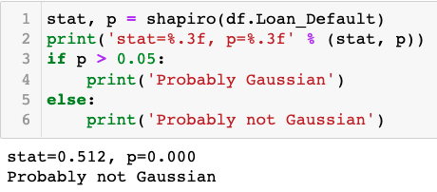
Statistical Method's
Hypothesis Testing: (Note: Checking hypothesis test on 95% Confidence.)
Normality Test: To know the data is following Gaussian Distribution or not.
Hypothesis testing on Normality using ShapiroTest
Null Hypothesis H0: Gaussian Distribution: If P>0.05 accept H0
Alternative Hypothesis H1: Not a Gaussian Distribution: If P<0.05 accept H1
Results
Hence P value is < 0.05 we reject the Null Hypothesis
So we conclude that data is not following the Normal Distribution
When the Data is not following Normal Distribution we can go for non parametric tests i.e. sample tests

Slide 16
Statistical Method’s for Feature Selection
Non-Parametric / Sample test:
Non Parametric Tests for Relationships
1. Categorical: Chi-squared test
2. Relationship between 2 continuous variables :
Spearman’s Correlation Co- efficient (also use for ordinal data)
Results:
As per test result P-Value is > Alpha for "Region_Name","Employment_Type","Date_of_Birth","CREDIT.HISTORY.LENGTH","DELINQUENT.ACCTS.IN.LAST.SIX.MONTHS" & "Asset_Cost" Hence H0/null hypothesis is Accepted for these features.
i.e there is no relationship between these features and targeted variable Loan_default.
Hence we can remove these features from our dataset

Slide 17
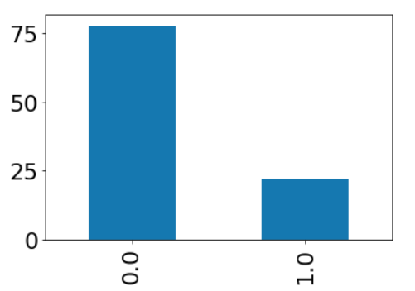
Changing the categorical in to Numerical
One Hot Encoding:
I applied the one hot Encoding to change categorical in to numerical
Balancing the Data
As the data is not balanced I applied the SMOTE technique to balance the data
To Standardize the data I applied StandardScaler

Slide 18
Splitting the data in to train and test
After data is cleaned I splitted the data in to Train and test in the ratio of 70 and 30 percentage.
After that I applied the models and tested the result.
Model Building
Tested Models:
1. Linear Regression
2. Logestic Regression
3. KNN METHOD
4. Decision Tree Method
5. Random Forest Classifier
6. Bagging Classifier
7. Ada Boost Classifier
Applied Hyperparameter Tuning using Grid Search

Slide 19
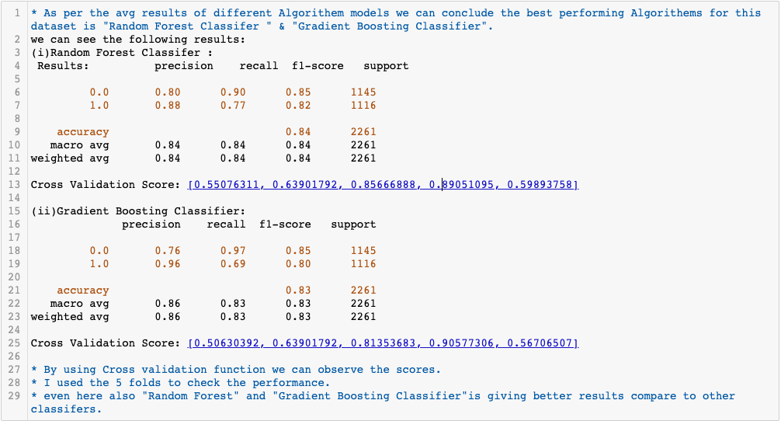
Cross Validation
I used the K_ fold cross validation to cross check the model performance

Slide 20
Recommendations
Observations:
Loan Defaulter’s:
Top loan Defaulters:
State: Jharkhand, TamilNadu, Maharashtra & Karnataka
Region: South
Employment: Self Employed
Relational changes :
Highest no. of Defaulters:
Self Employed: East Region
Salaried: South Region
States from Jharkhand, TamilNadu, Maharashtra & Karnataka Contributing highest no of loan defaulters.
Self employed are contributing more no. of Loan Defaulters.
And Self employed from East region and Salaried from South Region contributing highest no. of Load Defaulters.
Company has take more precautionary measures in to these states and type of people.

Slide 21
Thank You

